Slide 1
Neural nets

Slide 2
Outline
Perceptron and multi-layer perceptrons
Recurrent neural network
Long short-term memory

Slide 3





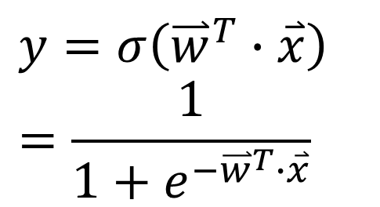

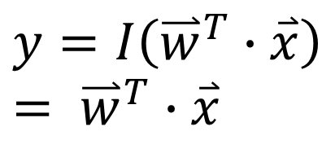








Perceptron is all you need
$$w_{1}$$
If f is I (identity function), the perceptron is linear regression:
$$x_{1}$$
$$w_{2}$$
$$y=I\left({\overset{⃑}{w}}^{T}∙\overset{⃑}{x}\right)= {\overset{⃑}{w}}^{T}∙\overset{⃑}{x}$$
$$x_{2}$$
$$w_{3}$$
$$\overset{⃑}{x}$$
$$x_{3}$$
$$+$$
$$f$$
$$\hat{y}$$
$$w_{4}$$
If f is sigmoid, the perceptron is logistic regression:
$$x_{4}$$
Activation
Output
$$w_{5}$$
$$y=σ\left({\overset{⃑}{w}}^{T}∙\overset{⃑}{x}\right)=\frac{1}{1+e^{−{\overset{⃑}{w}}^{T}∙\overset{⃑}{x}}}$$
$$x_{5}$$
Input

Slide 4
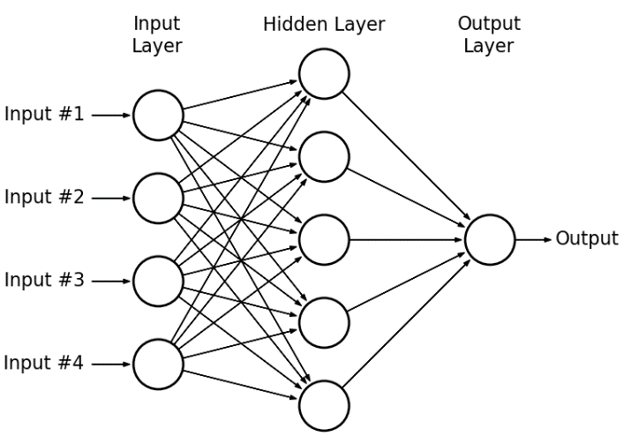

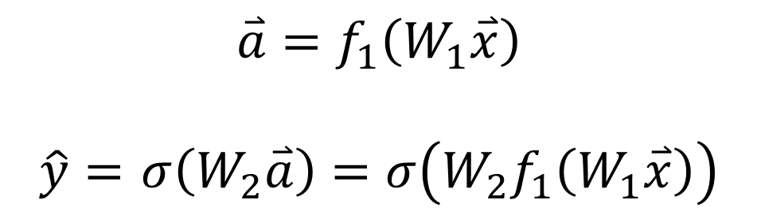


Multi-layer perceptron
$$\overset{⃑}{a}=f_{1}\left(W_{1}\overset{⃑}{x}\right)$$
$\hat{y}=$ $σ\left(W_{2}\overset{⃑}{a}\right)=σ\left(W_{2}f_{1}\left(W_{1}\overset{⃑}{x}\right)\right)$
Input layer:
Hidden layer:
Output layer:
Hornik, Kurt, Maxwell Stinchcombe, and Halbert White. "Multilayer feedforward networks are universal approximators." Neural networks 2.5 (1989): 359-366.
$$\overset{⃑}{x}$$
$$\overset{⃑}{a}$$
$$\hat{y}$$

Slide 5
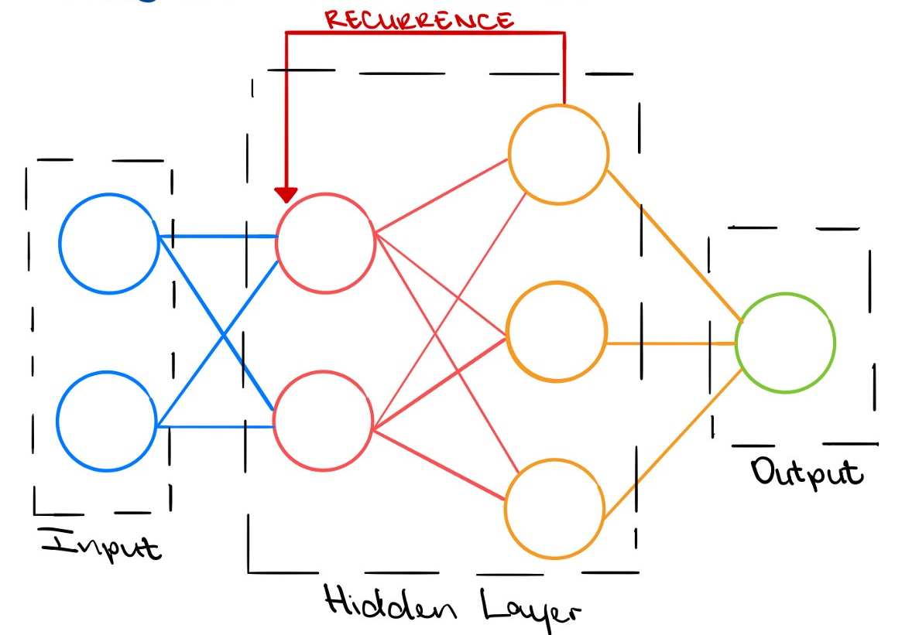

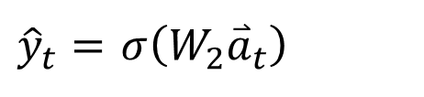



Recurrent Neural network
$${\overset{⃑}{a}}_{t}=f_{1}\left(W_{I}x_{t}+W_{R}{\overset{⃑}{a}}_{t−1}\right)$$
${\hat{y}}_{t}=$ $σ\left(W_{2}{\overset{⃑}{a}}_{t}\right)$
By simply adding the activation from the hidden layer back to the hidden layer, the network is time-dependent.
Input layer:
Hidden layer:
Output layer:
$$\overset{⃑}{x}$$
$$\overset{⃑}{a}$$
$$\hat{y}$$

Slide 6
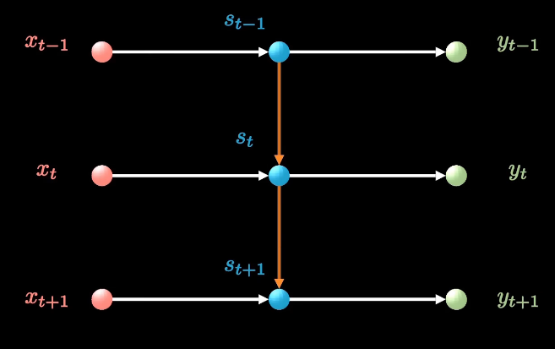
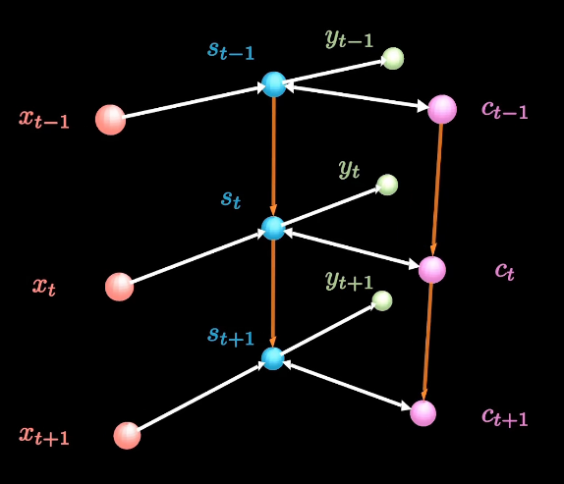
Long short-term memory
Short term memory
Video: https://www.bilibili.com/video/BV1Z34y1k7mc
Original paper: https://www.researchgate.net/publication/13853244_Long_Short-term_Memory (1997)
Review paper: https://link.springer.com/article/10.1007/s10462-020-09838-1 (2020)
Long term memory

Slide 7
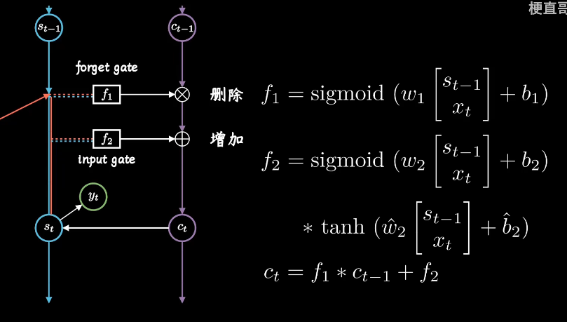

Slide 8
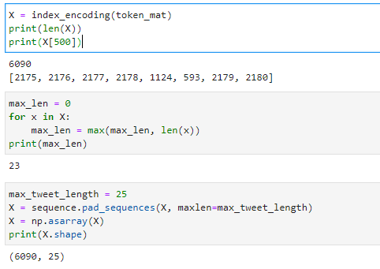
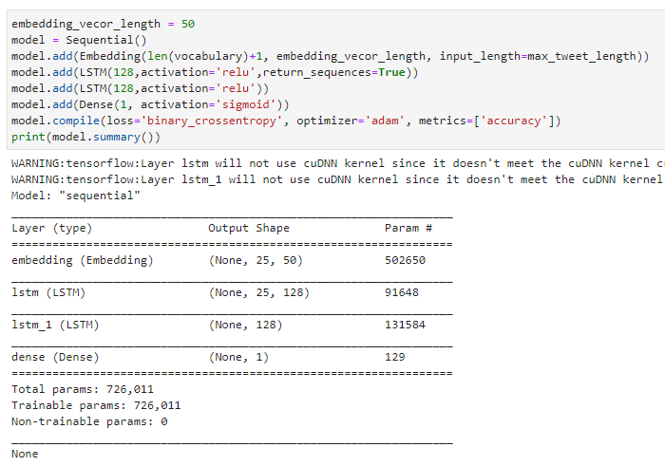
LSTM implementation
Data preparation
Compile the model

Slide 9
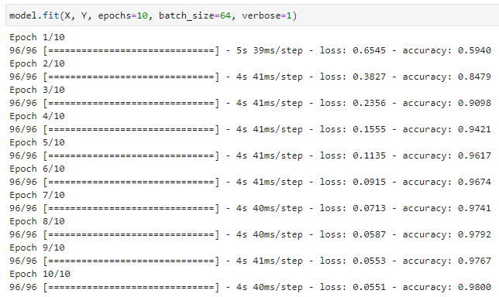

Training & evaluation
Training
Testing

